Slide 1
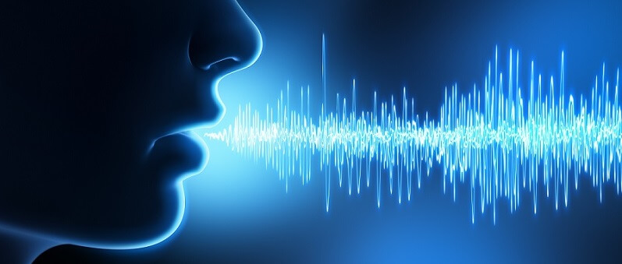
Parts of Speech Tagging CNN
Tristan Stuart
Bailie Delpire
Foram Patel
Johnathan Bevers
Marie McCord
CSCI 4850 Neural Nets
Final Project Presentation & Demo
May 3rd, 2021

Slide 2


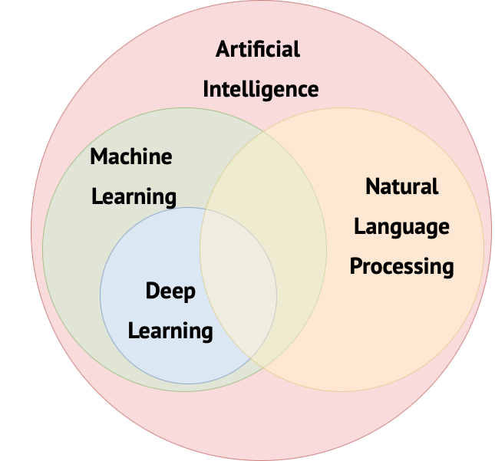
Motivations
NLP (Natural Language Processing) in AI has many uses
NLP in AI has come very far, but still has a ways to go
Recognizing parts of speech is one aspect of NLP
Do NLP and Neural Networks have a future together?

Slide 3
goals
Tag parts of speech using a neural network
Create a generic model prototype that can be trained for any language
Train and test for both English and Latin
Achieve a 93% or higher accuracy rate

Slide 4
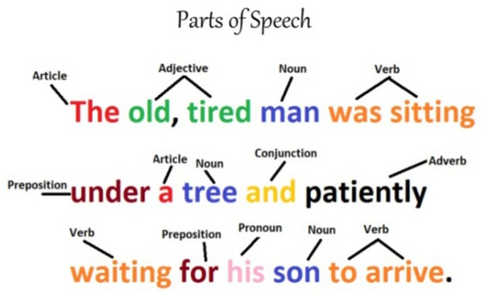
Tagged sentence example
Notes:
Very briefly explain what a tagged sentence is – super short maybe 30 seconds or less

Slide 5
Model pseudocode
Convolutional Neural Network
Embedding layer of pretrained word embeddings
Dropout layers and dense layers using relu (multiple pairs)
Dense output layer using softmax
Categorical Crossentropy loss function
Adam optimizer
Notes:
Briefly explain the general model prototype

Slide 6
training
English Model
Latin Model
Brown, Treebank, and Conll2000 corpora
Embedding matrix of Word2Vec’s pretrained Google News corpus
Universal Dependencies LLCT, ITTB, and PROIEL corpora
Embedding matrix of Word2Vec’s pretrained Continuous Skipgram of the Latin CoNLL17 corpus
*Corpus (plural corpora): a large and structured collection of text

Slide 7
Strategy
Padded input sequences with zeros for uniform size dimensions
Padding inflates accuracy rates
Measured accuracy using an existing masked accuracy function

Slide 8
Demo time

Slide 9

Results
English Model
Latin Model
98.57% Accuracy
96.54% Masked Accuracy
98.01% Accuracy
93.62% Masked Accuracy
Achieved all 4 goals!
Tag parts of speech using a neural network
Create prototype that can be trained for any language
Train and test for both English and Latin
93% or higher accuracy rate
Notes:
Here we can maybe talk about how and why the Latin model achieved a slightly lower accuracy rate (if anyone really knows why)
Emphasize that we were successful in achieving goals

Slide 10

Contributions
Tristan Stuart
Bailie Delpire
Foram Patel
Johnathan Bevers
Marie McCord

Slide 11
Questions?
Notes:
Approx 2 minutes for questions

